Slide 1
Photo Album
by (SP22-BSE-036)MUHAMMADMUJTABA

Slide 2
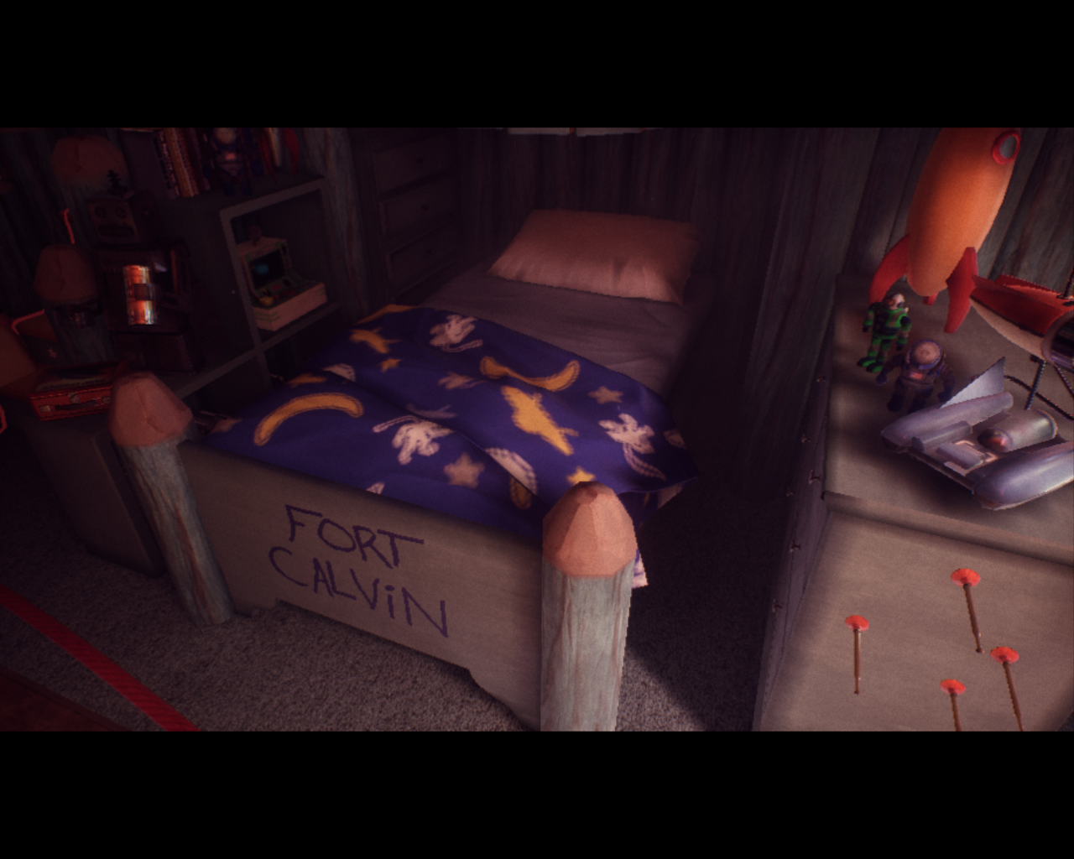

Slide 3
